Slide 1
ASSIGNMENT 1
Deadline: Feb 10th, 2017
Total Score: 200 Points

Slide 2
before YOU START
This is your first assignment, try to use all you have learned in lectures and solve all questions on your own.
You are required to use Jupyter Notebook to finish all the coding and save your works as ’ipynb’ files.
Create a new file for each question.
Write markdown title with question detail in the very first line.
Try to write your code in separated small blocks when you use notebook.
Try add comments in your code.
Proper output with clear title. (If the result is just a number or few words)

Slide 3
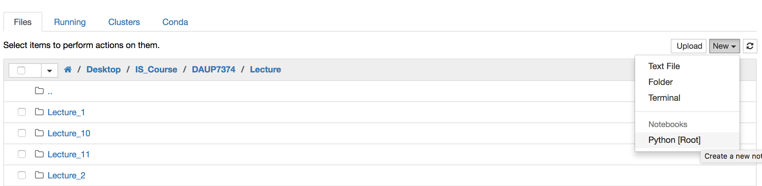
Here is an example

Slide 4
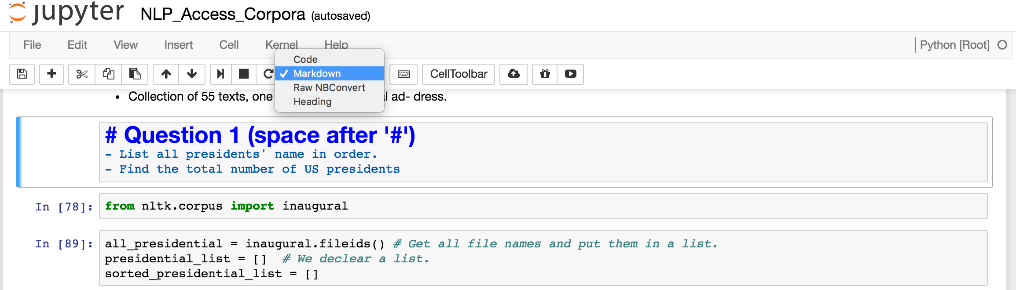

Slide 5
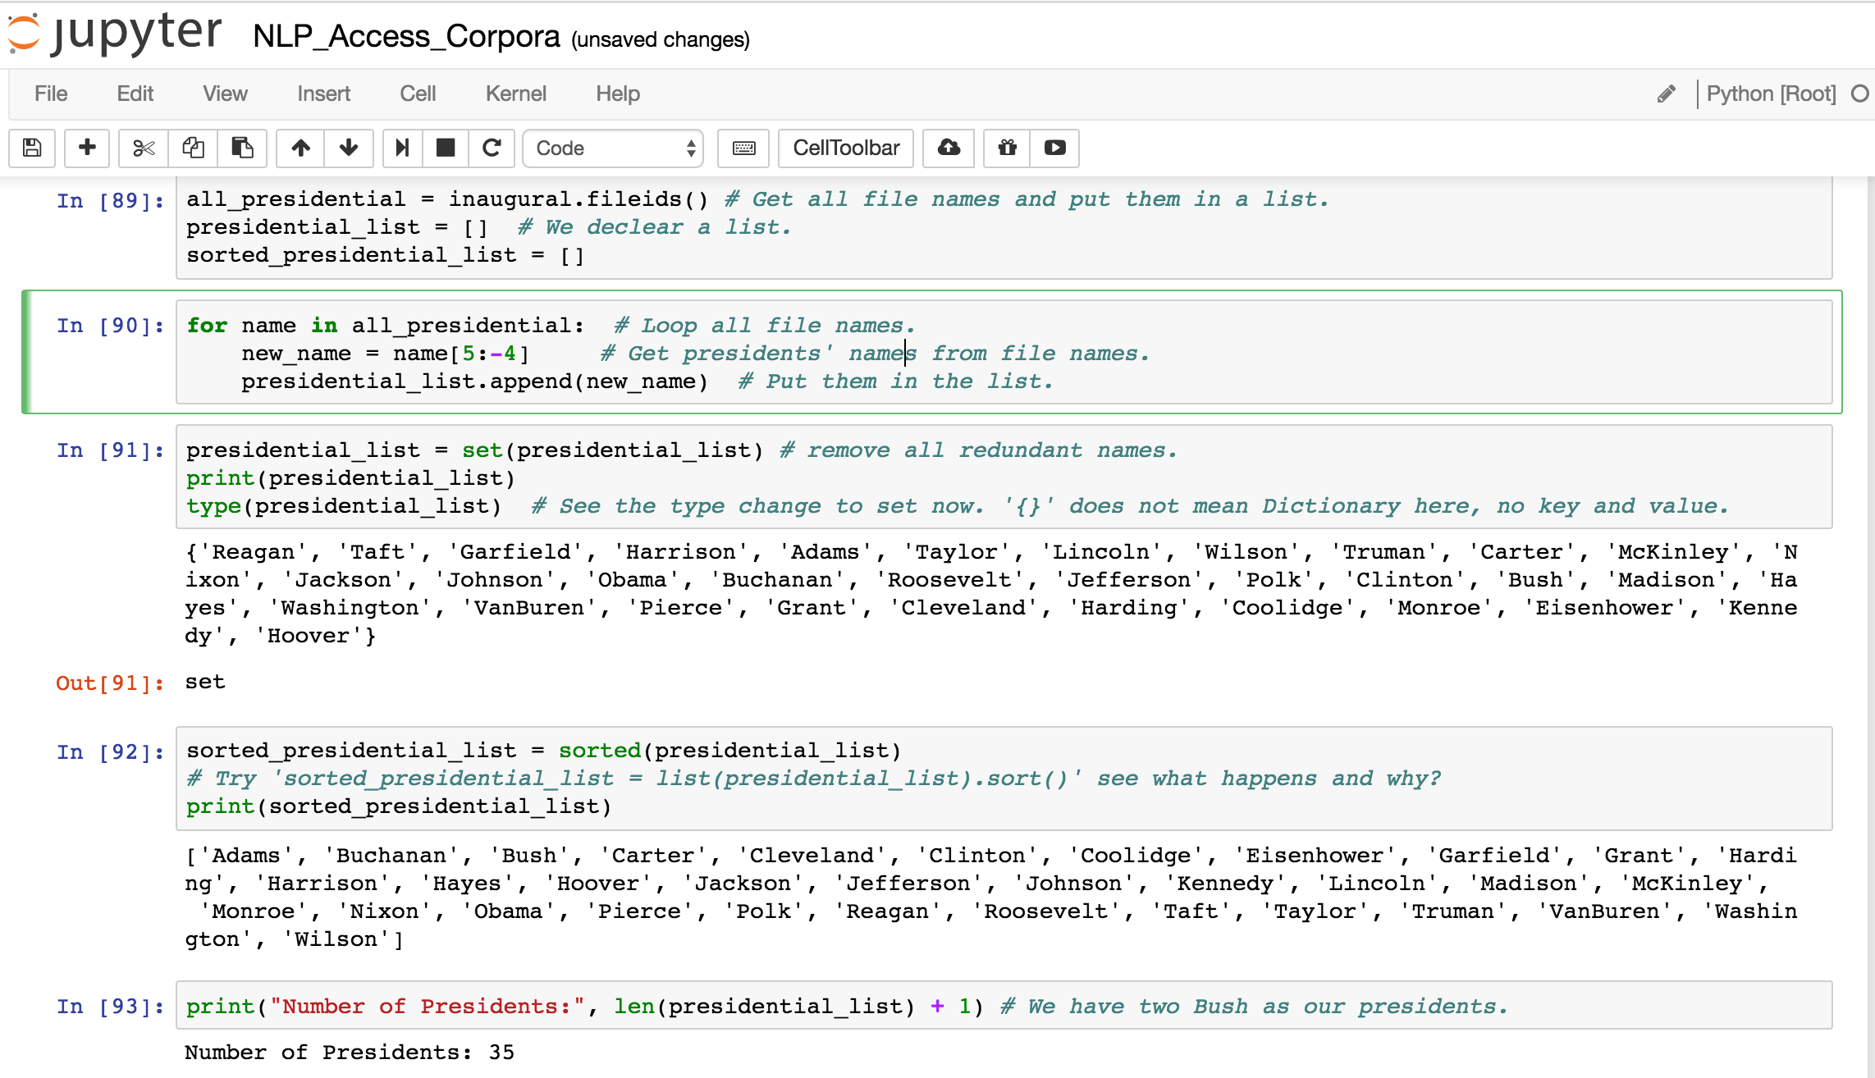

Slide 6
Question 1
Under package Gutenberg, see what files are in it.
Find out how many words and how many unique words in file 'austen-persuasion.txt'.
Calculate the frequency for each words and show the top 10 most frequent words and their frequency. Try NOT to use FreqDist module.
Keep the punctuation and stop words in this question.

Slide 7
Question 2
Under package Gutenberg get content from file 'melville-moby_dick.txt.' (HINT: Words? Raw?)
Find out frequency of 26 characters. (Turn uppercase into lowercase and count as one character)
List all 26 characters in order base on their frequency. (From most frequent to least frequent) Try NOT to use FreqDist module.

Slide 8
Question 3
Under package Webtext, see what files are in it.
Get content in file 'pirates.txt'.
According to the number of lines for Jack Sparrow and Will Turner, find out who is the real leading man in this movie.

Slide 9
Question 4
Under package nps_chat, see what files are in it.
Find 'user121' and see how many posts he posted in all.
Find out how many unique user in each age range group. (20s, 30s,...)(Hint: files' name)

Slide 10
Question 5
Use Gutenberg and Web_text data. Find out what are the top 5 words that Shakespeare used but we do not use in currently.
Take top 50 words from Shakespeare (all 3 books) and top 50 from Web_text (all the records).
Remove punctuation and stop words.
Remove the words we still use today, and get the unused list. Show the top 5 elements.

Slide 11
Question 6
Under Inaugural Address package
For every president, find out how many unique words they used in speech.
We will just assume that President Bush means one person (technically it is incorrect but we will ignore it)

Slide 12
question 7
Use Name corpus, calculate the probability of a name being of a male or female base on the last character(s) of name.
Sample steps:
For char ‘a’:
total_names = sum(names ending with ‘a’)
male_names = sum(male names ending with ‘a’)
female_names = sum(female names ending with ‘a’)
Probability of name being male = 100 * male_names / total_names
2. Do this for all characters.
Output must come with proper title (e.g. [a] male: 25%, female: 60%)

Slide 13
question 8
Use nps_chat and wordlist corpus.
If you find a word in nps_chat but not in wordlist, it is considered an unusual word. (e.g. Heyyyy, gr8, 4ever can be considered unusual words for this analysis)
Find out how many unusual words people speak in chat (notice: usernames should not be counted)
Bonus: What if I want to count : ) , : ( all these emoticons in. (optional)

Slide 14
after YOU DONE
Make sure your code is runnable.
Please check if your code and output fulfil requirements.
Submit your work on your GitHub under a new repository. (DO NOT ZIP!)
DO NOT update your file after the dead line. (Late submission may cut points)
Please add TJ as a collaborator to your repository on GitHub.
Email: song.ti@husky.neu.edu
PLEASE DO NOT COPY OTHER’S WORK !!!

